Slide 1


COSC 380 Pendant Automation Internship
Jeremy Scheuerman

Slide 2
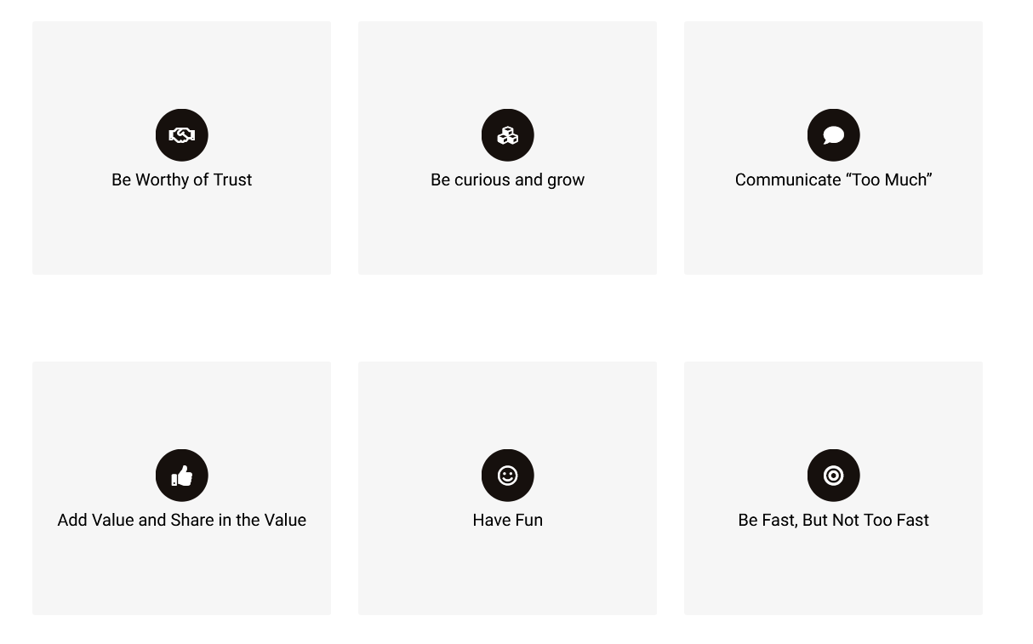
About us
Founded by my boss Rob Ward
We specialize in Industrial Automation in warehouse conveyer systems.
Relatively small team, everyone with their own skills
Use of PLC controllers
A lot of electricians and work with electrical
Virtualbox and vmware experience
Python programming and mysql
Our Office is in Harve De Grace Maryland
Americas Top 5000 fastest growing businesses
200% growth last year and on track for growth of 300+% this year!

Slide 3
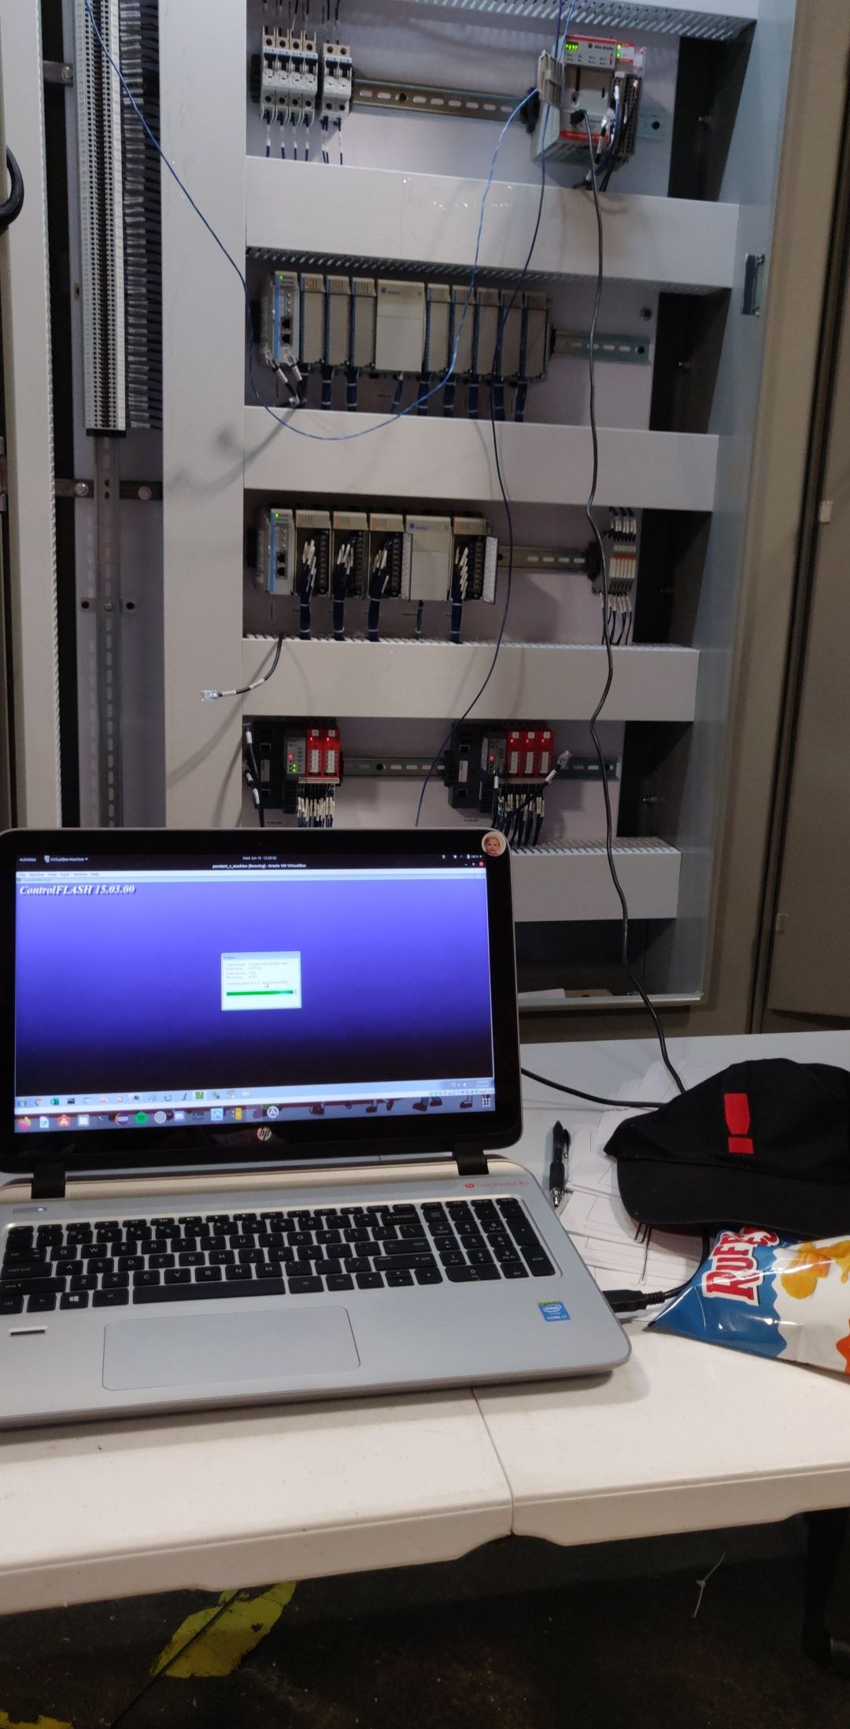
Panel Testing
Trained in PLCs and panel testing by my supervisor/boss James
User Virtual Box with rockwell virtual machine with rockwell tools
Ip Address all logic controllers, Update Firmware Of CPU logic controller
Flash Plc Program and then fix all discrepancies
I/O check all outputs ,Verify voltages in control Panel
Make sure all motor protectors are set, Resolve plc errors
I have tested many panels for amazon (my initials are in their panels in the warehouses right now!) , pampered chef, Eby-Brown (convenience store suppliers)
Was awesome being around non programmers in the panel shop,I learned a lot from Brad Bilbo and John, especially brad he taught me alot,ex:wire to ground, lock tagout, importance of UL labels ,termination screwdrivers, and alot of safety procedures.

Slide 4
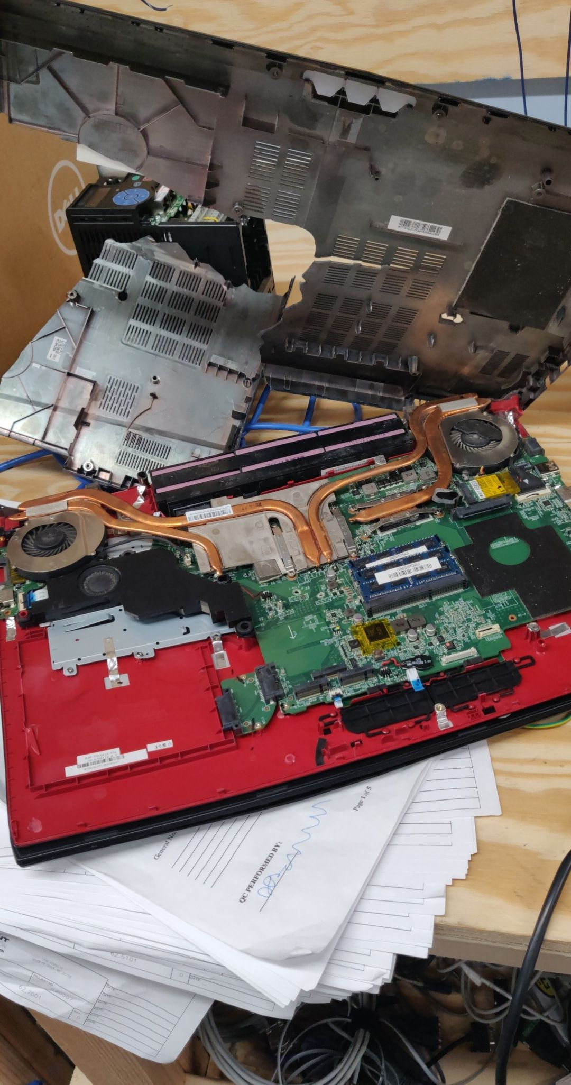
Funny Story
Rob Ward + Trying to run a vm off of 3 gigabytes of Ram
Result: Not good for the laptop (sorry James)
I called him over to help with an issue I was having with the vm
Multiple times in the past he commented on how terrible the laptop was he said “and I quote “ I’m surprised you don’t smash it
When it pushed him past his patience, he picked it up and….R.I.P. to the MSI
I wanted to do the same thing for a really long time

Slide 5
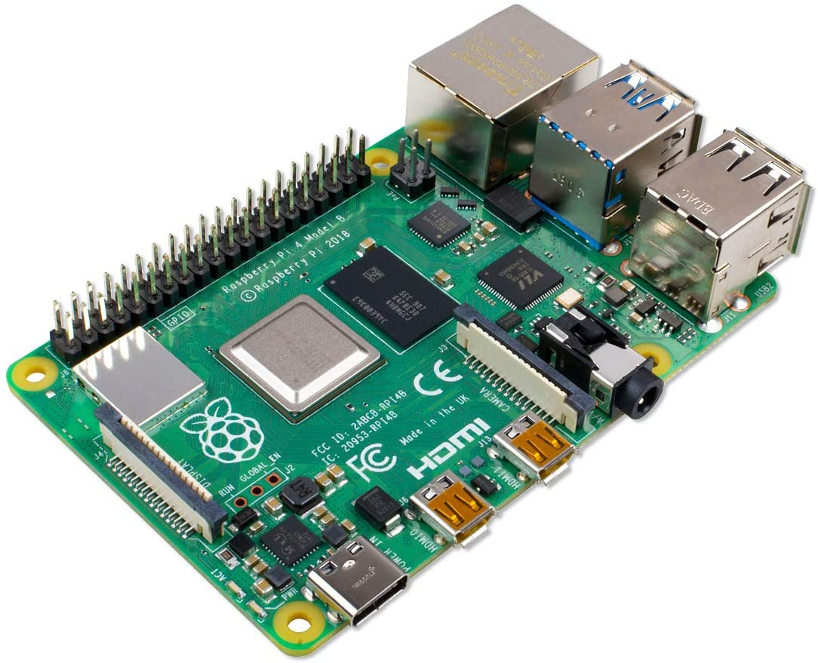

Linux Experience
I loaded Linux onto my personal laptop as a way to force myself to get experience
Then my boss put me in charge of programming raspberry pis
This gave me an advantage because I am the only linux user who works at pendant
I knew where to go to set boot params for the rapbserry pis ( I believe it was Debian Jesse or Buster not quite sure which one)
I have become more experienced in terminal (although I have along way to go)
Troubleshooting the raspsberry pis and my own machine has helped me understand how this awesome os works (linux will be my primary os on all laptops moving forward)

Slide 6

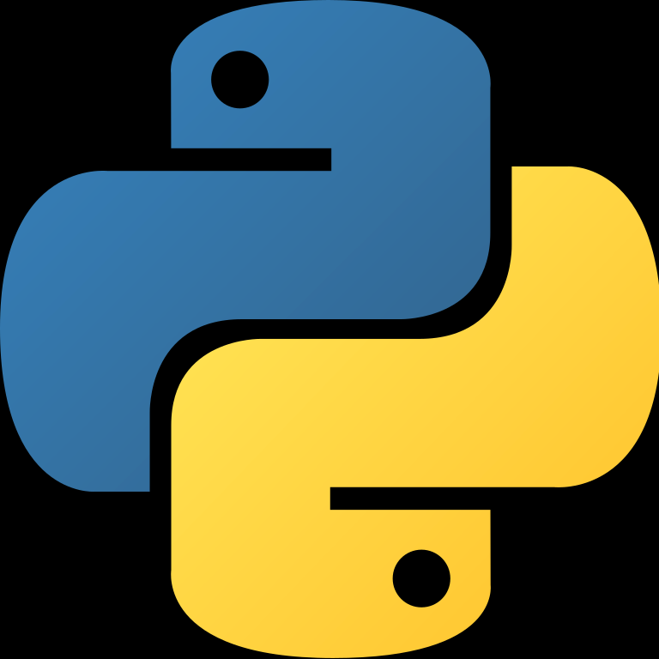
Python and Mysql
My boss began assigning me python projects to take stress off of him, he is the only other non webdev programmer (Julianna is our web developer part time,she goes to umd) besides me (at the time)
Project Dat converter, take .dat file split it into separate .dat files and upload it to mysql database
When I asked for guidance on My sql he said (I don’t know I have zero experience in it too, figure it out) so that’s what I did I started teaching myself mysql
Script creates databases dynamically in the code and deletes them automatically after 30 days
Raspberry pi projects, python script to constantly display warehouse schedules to boards in north Carolina and Florida, I also installed watchdog to auto reboot and set some autostart boot configs in the pi settings

Slide 7
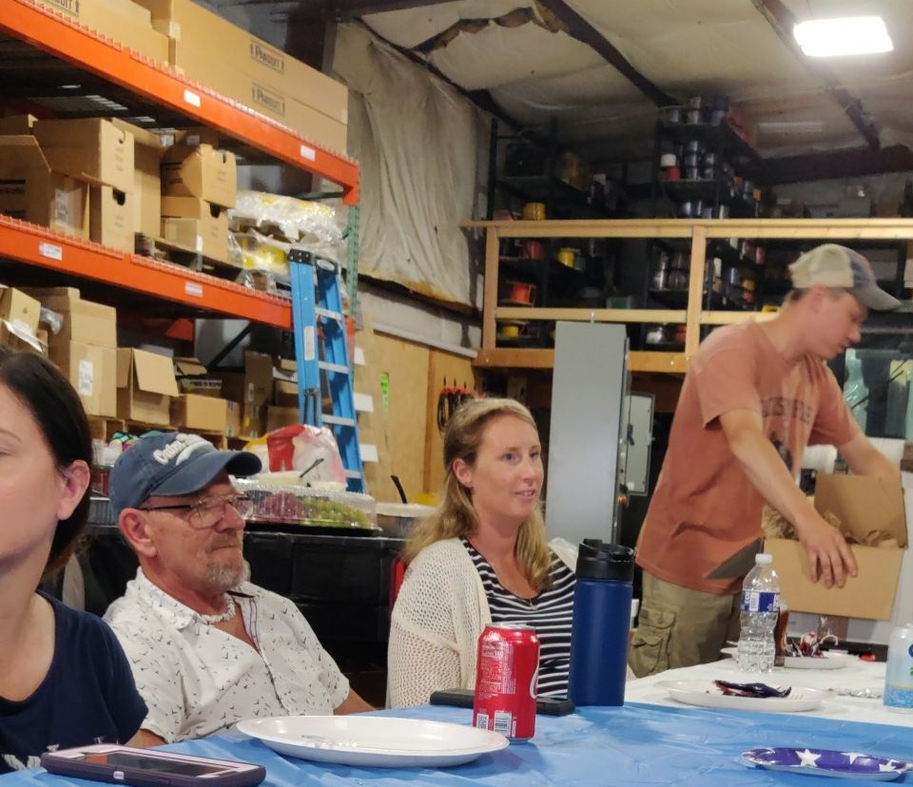
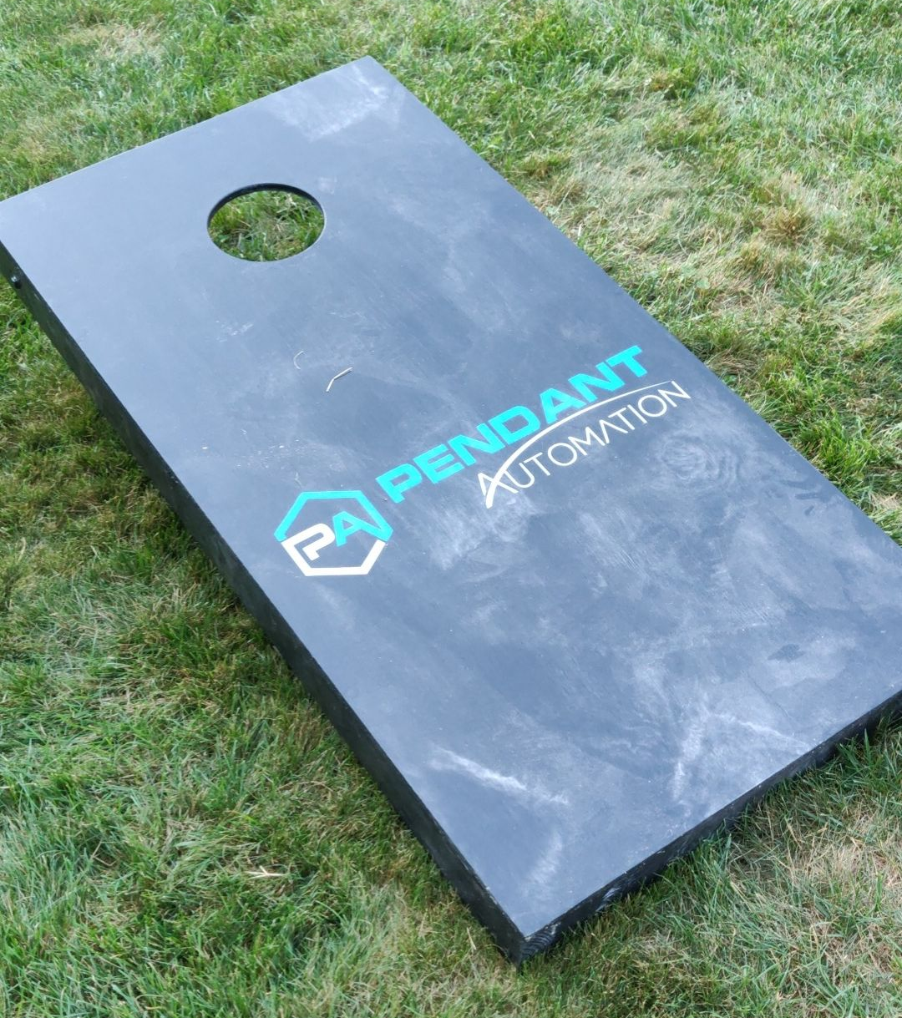
Work Environment
My boss treats every single one of his employees with fairness and respect
Orders us pizza sometimes and buys snacks for the office
Pendant Day! Celebration of when pendant was founded, we come in to work and get paid to play games together and Rob cooks food for us,
4th of July- rob invited all of us to his house for a cookout on the 4th of July as well.
Long story short.. My boss is awesome, he has a great way of running things it makes me want to stay, I feel respected appreciated and understood

Slide 8

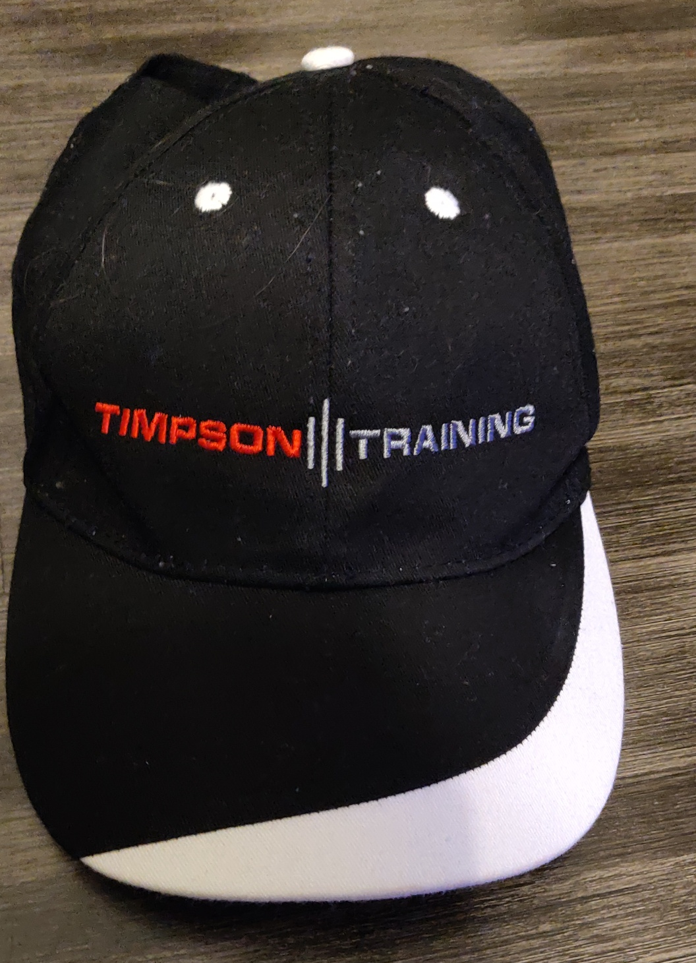
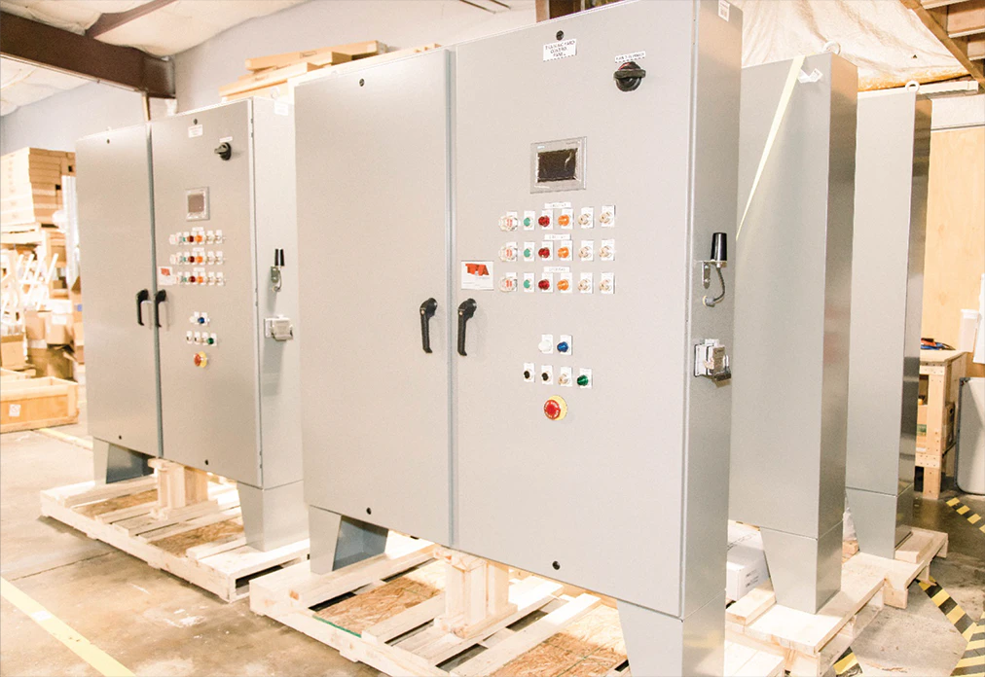
Timpson Training
My bosses second company owned 50% by him and 50% by Caleb Thompson
Him and Caleb worked together creating a device to allow lineman to work on live circuits without getting electrocuted if things go wrong (how the device works I'm not sure)
Pendant and Timpson use the same office, we build panels for Timpson related stuff all the time
Timpson is awesome thanks to Rob and Caleb’s idea we can save lives!

Slide 9
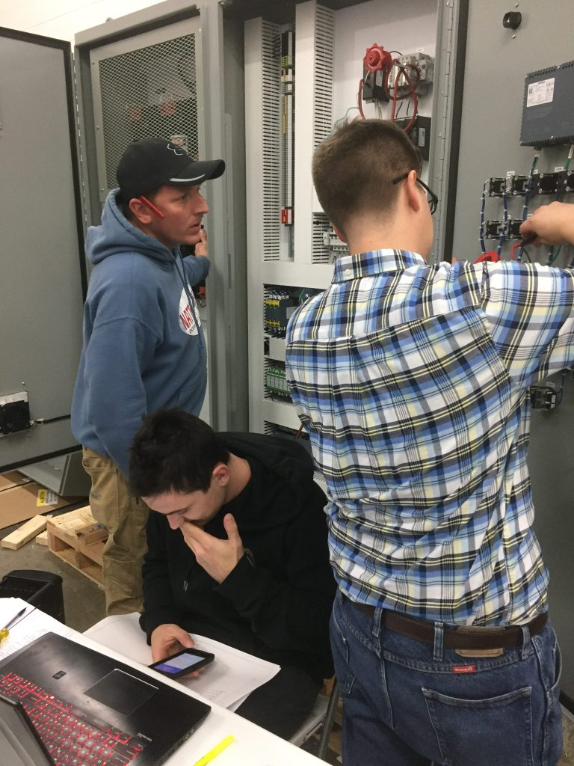
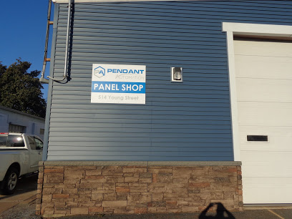
The Future With pendant
I loved working with Pendant Automation, we have a great team and a great leader, I will be there next summer and for the time being I plan to stick around after graduation as well
Atthe end of the summer my duties have shifted more yo focus on programming rather than panel testing
To pickup slack since I left since Rob’s duties are growing due to the growth of the company they have hired another software developer Craig Macvior to pickup some of the work
I have already reached out to him touch base and I look forward to working with him
Pendant’s Future looks very bright, whether I’m part of their team for 5 more years or 25 I know they will do great things ☺

